Slide 1
Investigating the effectiveness of Machine Learning in Cybersecurity and how it defends against Data Mining

Slide 2
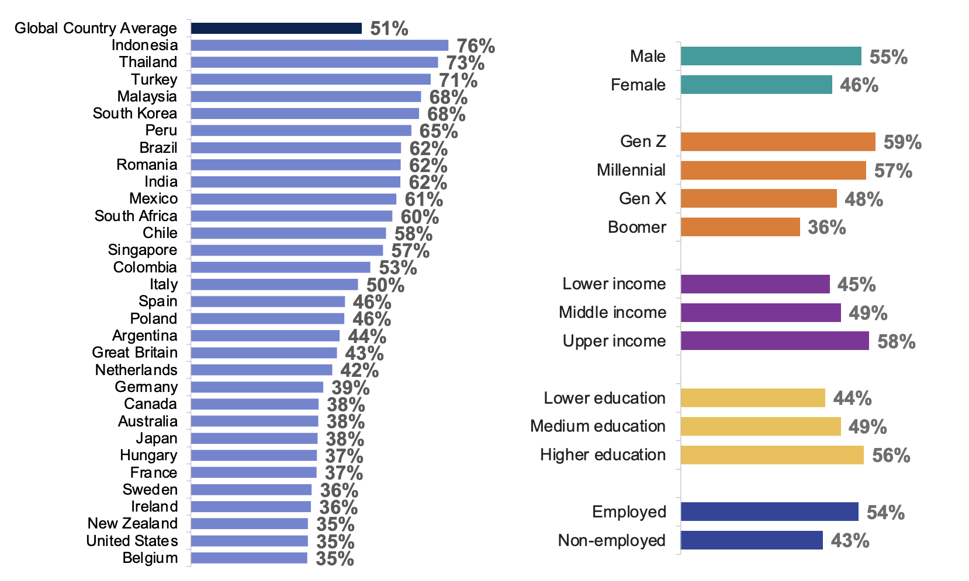
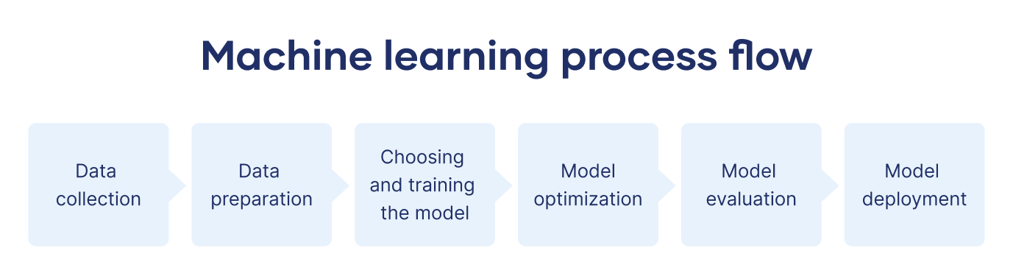
Machine learning and its uses
Machine Learning (ML) is a subset of AI and is coded to function similarly to the human brain. Initially, it is inefficient and makes a lot of mistakes, but over time it becomes more accurate.
(Hosch, 2024)
Machine Learning is used for many various tasks. A few examples include:
Biometric Systems
Product Recommendations
Neural Networks
Cyber Security
(Cipriani, 2020), (NVIDIA, 2021)
Figure 1: Global Understanding of AI and Machine Learning

Slide 3

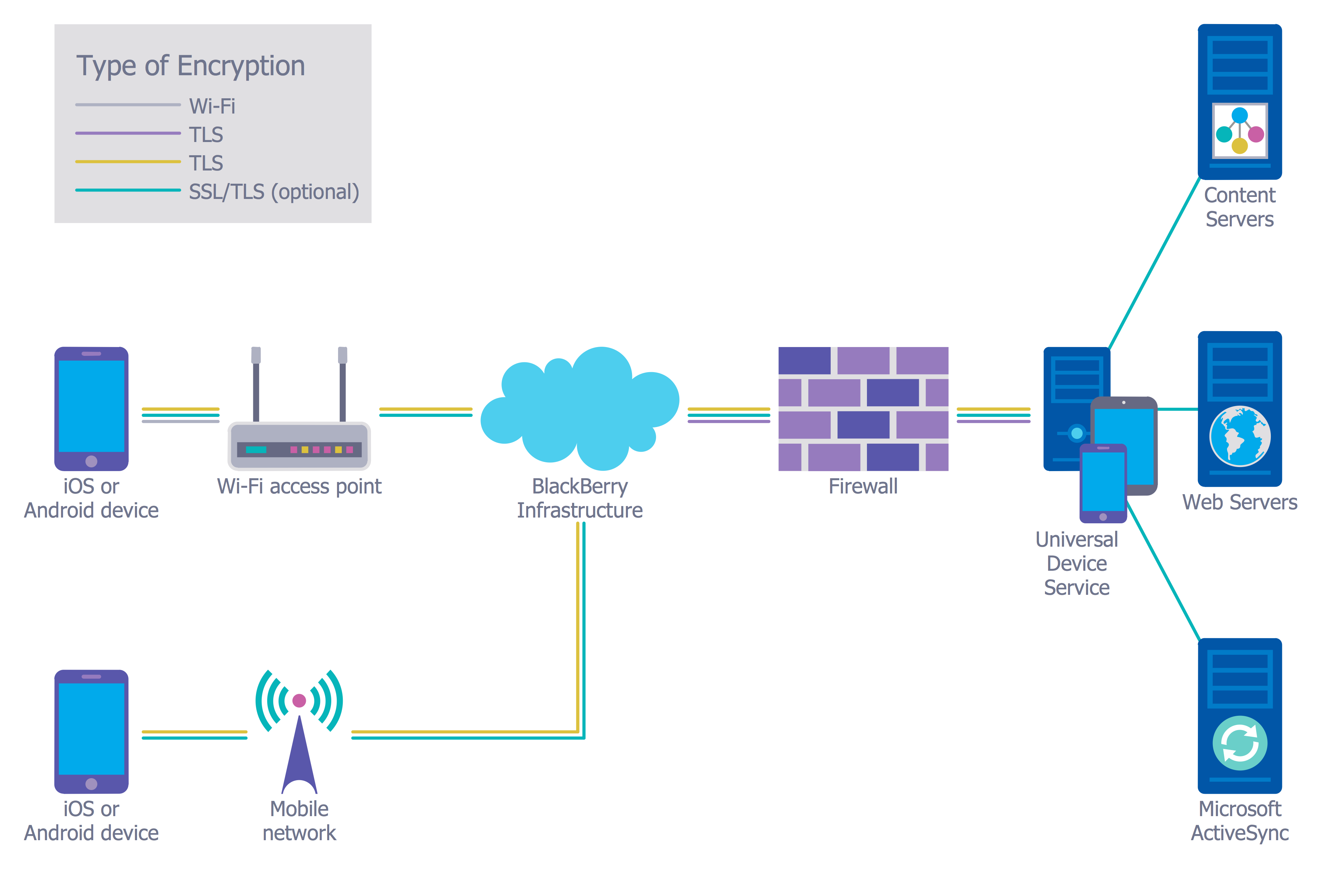
Cybersecurity and machine learning
Cybersecurity is the process of lowering the risk of cyber-attacks and defending against potential attacks through different methods:
Firewalls
Intrusion Monitoring
Encryption
(NCSC, 2016)
Machine Learning is used to “identify and respond to security incidents” (IBM, 2024), as well as to analyse data for potential patterns (Cisco, 2023).
Figure 2: Web-attacks globally 24/10/2024 at 13:37

Slide 4
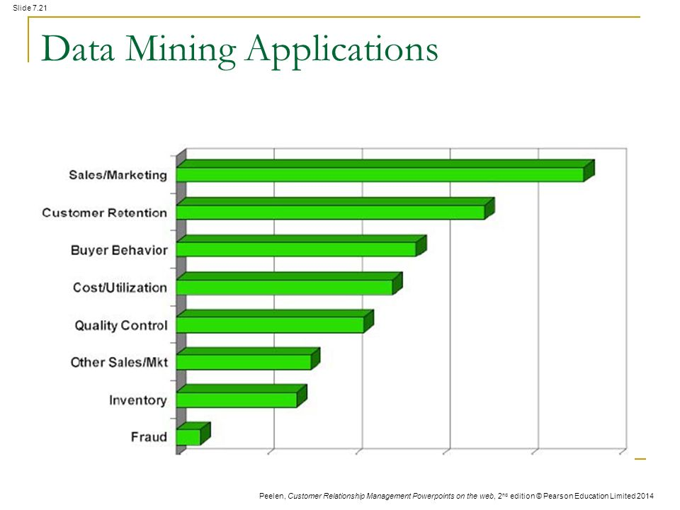
Data mining and cybersecurity
Data Mining is a process by which data is analysed for patterns and links within large data sets. Its versatile nature can prove highly beneficial in business (Sales, Marketing and IT), scientific research and criminal detection.
(Holdsworth, 2024)
Despite being invaluable for organisations, cybercriminals also use Data Mining. Cybercriminals use Data Mining to:
Scan networks automatically for specific data to steal
Access client information to scam them more effectively
(Smith, 2009)
Figure 3: 9 Most Common Applications of Data Mining

Slide 5
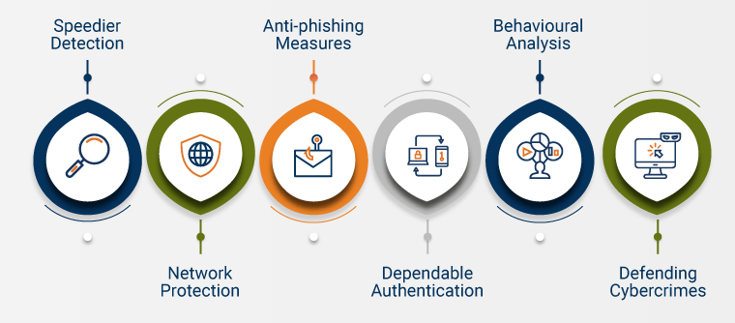
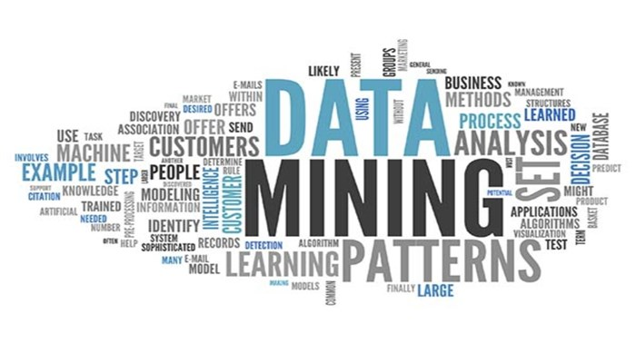
How machine learning defends against data mining
Data Mining is most often used for corporate purposes however, cybercriminals will use it nefariously. Companies have been forced to use Machine Learning to defend against these cybercriminals.
Since Machine Learning and Data Mining are “complementary in nature”, it allows for Machine Learning technologies to develop “highly predictive models” to anticipate where the cybercriminals will strike.
(Shams, 2023)
Figure 4: Ways Machine Learning defends against Data Mining

